Slide 1
JavaScript
&
DOM – Document Object Model

Slide 2
Overview of JavaScript
History
    Brendan Eich wrote JavaScript in 10 days, in May 1995.
    Was developed under the name Mocha.
    It was officially called LiveScript when it first shipped in beta releases of Netscape Navigator 2.0 in September 1995.
    It was renamed to JavaScript when it was deployed in the Netscape Navigator 2.0 beta 3 in December.
Why JavaScript was created?
    A company called Netscape was founded in 1994 and created one of the first web browsers. They recruited Eich in 1995, because they wanted him to create a programming language for that web browser. ... It quickly gained popularity and influenced Netscape's decisions regarding JavaScript
  JavaScript is an interpreted language, not a compiled language.
  Client-side JavaScript is very fast because it can be run immediately within the client-side browser.
  Currently used by 94.5% of all websites
  JavaScript is very popular and adopted universally by every web browser for its support which allows dynamic content to get execute in a webpage.
2

Slide 3
Object Orientation & JavaScript
Object Oriented JS:
JavaScript is not an object-oriented programming language. Rather, it is an object-based language.
JavaScript does not have classes. Its objects serve both as objects and as models of objects.
Without classes, JavaScript cannot have class-based inheritance, This is done with the prototype object; thus, this form of inheritance is called prototype-based inheritance
Java Script Object:
A JavaScript object appears, both internally & externally, as a list of property–value pairs.
The properties are names; the values are data values or functions.
All functions are objects and are referenced through variables.
The collection of properties of a JavaScript object is dynamic; Properties can be added or deleted at any time during execution. Every object is characterized by its collection of properties,
3

Slide 4
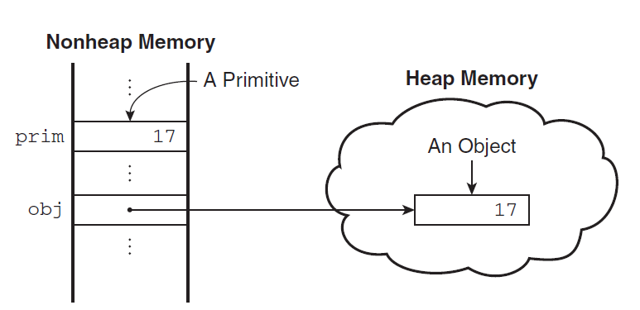
Primitives in JavaScript
Primitives in JavaScript
JavaScript has five primitive types:
  Number
  String
  Boolean
  Undefined
  Null.
The difference between primitives and objects is shown in the following example. Suppose that prim is a primitive variable with the value 17 and obj is a Number object whose property value is 17.
Below Figure shows how prim and obj are stored.
4

Slide 5
Numeric Literals
Numeric Literals
All numeric literals are primitive values of type Number.
The Number type values are represented internally in double-precision floating-point form. Because there is only a single numeric data type, numeric values in JavaScript are often called numbers.
Literal numbers in a script can have the forms of either integer or floating-point values.
Integer literals are strings of digits. Floating-point literals can have decimal points, exponents, or both.
Exponents are specified with an uppercase or a lowercase e and a possibly signed integer literal.
  The following are valid numeric literals:
72 7.2 .72 72. 7E2 7e2 .7e2 7.e2 7.2E-2
5

Slide 6
String Literals
String Literals
A string literal is a sequence of zero or more characters delimited by either single quotes (') or double quotes (").
String literals can include characters specified with escape sequences, such as \n and \t. If you want an actual single-quote character in a string literal that is delimited by single quotes, the embedded single quote must be preceded by a backslash:
  'You\'re the most freckly person I\'ve ever seen‘
A double quote can be embedded in a double-quoted string literal by preceding it with a backslash.
An actual backslash character in any string literal must be itself backslashed, as in the following example:
"D:\\bookfiles“
There is no difference between single-quoted and double-quoted literal strings.
The null string (a string with no characters) can be denoted with either '' or "".
All string literals are primitive values.
6

Slide 7
Other Primitive types
Other Primitive Types
The only value of type Null is the reserved word null, which indicates no value.
A variable is null if it has not been explicitly declared or assigned a value.
If an attempt is made to use the value of a variable whose value is null, it will cause a runtime error.
The only value of type Undefined is undefined. Unlike null, there is no reserved word undefined.
If a variable has been explicitly declared, but not assigned a value, it has the value undefined.
If the value of an undefined variable is displayed, the word undefined is displayed.
The only values of type Boolean are true and false. These values are usually computed as the result of evaluating a relational or Boolean expression
The existence of both the Boolean primitive type and the Boolean object can lead to some confusion.
7

Slide 8
JavaScript Operations
Numeric Operators
JavaScript has the typical collection of numeric operators:
The binary operators:
  + for addition
  - for subtraction
  * for multiplication
  / for division
  % for modulus.
The unary operators are plus (+), negate (-), decrement (--), and increment (++).
The increment and decrement operators can be either prefix or postfix.
As with other languages that have the increment and decrement unary operators, the prefix and postfix uses are not always equivalent.
For example, if the variable a has the value 7,
    (++a) * 3 is 24
    (a++) * 3 is 21
In both cases, a is set to 8.
8

Slide 9
Math & String Objects
The Math Object:
The Math object provides a collection of properties of Number objects and methods that operate on Number objects.
The Math object has methods for the trigonometric functions, such as sin (for sine) and cos (for cosine).
Other mathematical operations include
  Floor: to truncate a number
  Round: to round a number
  Max: to return the largest of two given numbers.
String Concatenation Operator
JavaScript strings are not stored or treated as arrays of characters; rather, they are unit scalar values.
String catenation is specified with the operator denoted by a plus sign (+).
9

Slide 10
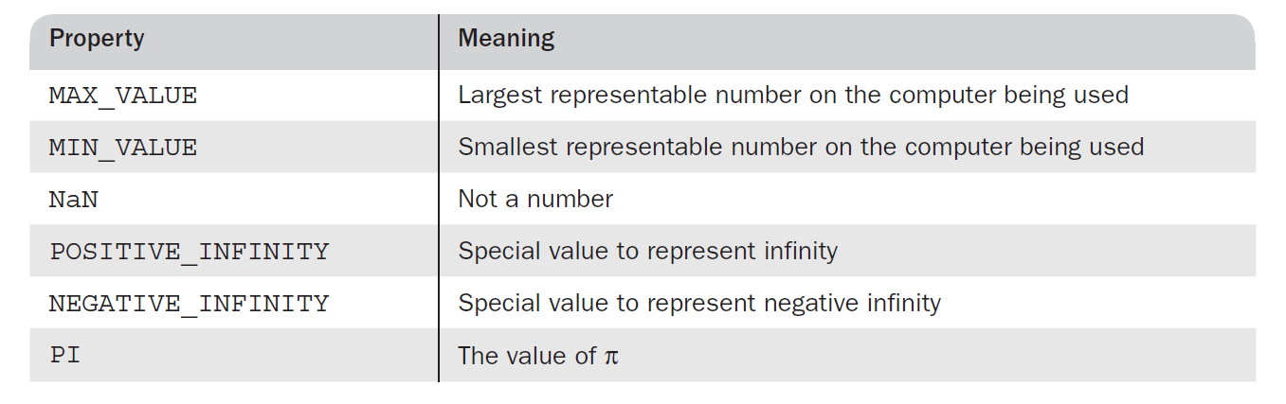
Number Object
The Number Object:
This object includes a collection of useful properties that have constant values.
Any arithmetic operation that results in an error such as
  division by zero
  that produces a value that cannot be represented as a double-precision floating point number, such as a number that is too large (an overflow),
returns the value “not a number,” which is displayed as NaN.
If NaN is compared for equality against any number, the comparison fails.
Surprisingly, in a comparison, NaN is not equal to itself.
To determine whether a variable has the NaN value, the predefined predicate function isNaN() must be used.
For example, if the variable a has the NaN value, isNaN(a) returns true.
The Number object has a method, toString, which it inherits from Object but overrides.
10

Slide 11
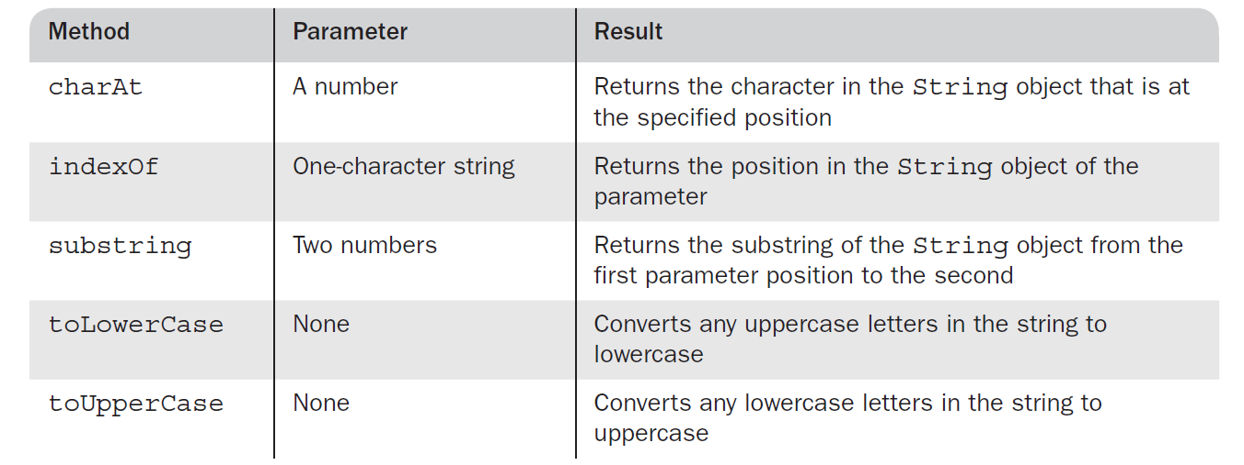
String Object
String Properties and Methods
String methods can always be used through String primitive values, as if the values were objects.
The String object includes one property, length, and a large collection of methods.
The number of characters in a string is stored in the length property as follows:
  var str = "George";
  var len = str.length;
In this code, len is set to the number of characters in str, namely, 6.
A few of the most commonly used String methods are shown in Table.
11

Slide 12
typeof operator
The typeof Operator
The typeof operator returns the type of its single operand.
typeof produces "number", "string", or "boolean" if the operand is of primitive type Number, String, or Boolean, respectively.
If the operand is an object or null, typeof produces "object".
Objects do not have types. If the operand is a variable that has not been assigned a value, typeof produces "undefined", reflecting the fact that variables themselves are not typed.
Notice that the typeof operator always returns a string. The operand for typeof can be placed in parentheses, making it appear to be a function. Therefore, typeof x and typeof(x) are equivalent.
12

Slide 13
Assignment operator
Assignment Operator
The assignment statement in JavaScript is exactly like the assignment statement in other common C-based programming languages.
There is a simple assignment operator, denoted by =, and a host of compound assignment operators, such as += and /=.
  For example, the statement
    a += 7;
means the same as a = a + 7;
JavaScript has two kinds of values: primitives and objects.
A variable can refer to a primitive value, such as the number 17, or an object.
Objects are allocated on the heap, and variables that refer to them are reference variables. When used to refer to an object, a variable stores an address only.
Assigning the address of an object to a variable is fundamentally different from assigning a primitive value to a variable.
13

Slide 14






Assignment operator
JavaScript Assignment Operators
Assignment operators assign values to JavaScript variables.
Operator | Example | Same As
= | x = y | x = y
+= | x += y | x = x + y
-= | x -= y | x = x - y
*= | x *= y | x = x * y
/= | x /= y | x = x / y
%= | x %= y | x = x % y
<<= | x <<= y | x = x << y
>>= | x >>= y | x = x >> y
>>>= | x >>>= y | x = x >>> y
&= | x &= y | x = x & y
^= | x ^= y | x = x ^ y
|= | x |= y | x = x | y
**= | x **= y | x = x ** y
14

Slide 15
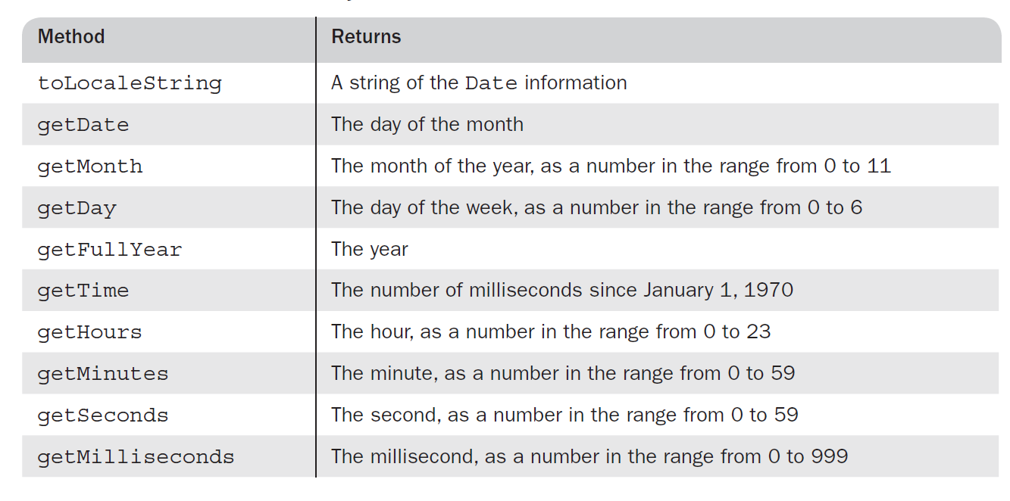
Date Object
The Date Object
A Date object is created with the new operator has the Date constructor, which has several forms.
Date constructor, which takes no parameters and builds an object with the current date and time for its properties.
For example, we might have
  var today = new Date();
The date and time properties of a Date object are in two forms:
  Local
  Coordinated Universal Time (UTC), which was formerly named Greenwich Mean Time.
Table aside shows the methods, along with the descriptions, that retrieve information from a Date object.
15

Slide 16
Implicit vs Explicit Conversation
Implicit vs Explicit Conversations
Implicit Conversations | Explicit Conversations
Implicit Conversion is done automatically. | Explicit Conversion is done programmatically.
In Implicit conversion, no data loss take place during the data conversion. | In explicit conversion, data loss may or may not be take place during data conversion. Hence there is a risk of information loss.
No possibility of throwing exception during the conversion and therefore is called type safe. | It might throw error if tried to do without type casting.
Implicit conversion do not require any special syntax. | Explicit conversion do require cast operator to perform conversion.
Example : Conversion of smaller number to larger number is implicit conversion. Conversion of integer type data to float. float i=0; int j=10; i=j; // This is implicit conversion since float is larger than integer,hence no loss of data & no exception. | Example : Conversion of larger number to smaller number is explicit conversion. float k=123.456 int i= (int) k // This is Explicit conversion and (int) is type cast operator. Here we may be able to escape an exception but there is noticeable data loss.i.e. i=123 // .456 is lost during conversion
16

Slide 17

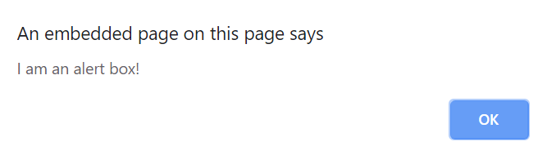

Screen output & Keyboard input
JavaScript has three kind of popup boxes:
  Alert box.
  Confirm box.
  Prompt box.
Alert Box
An alert box is often used if you want to make sure information comes through to the user.
When an alert box pops up, the user will have to click "OK" to proceed.
The window.alert() method can be written without the window prefix.
17

Slide 18

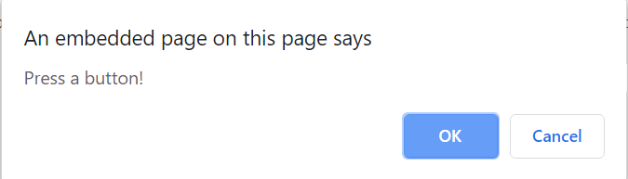
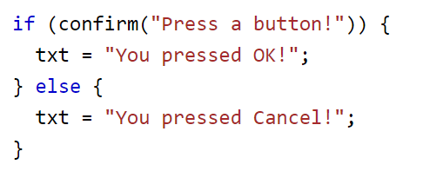
Screen output & Keyboard input
Confirm Box
A confirm box is often used if you want the user to verify or accept something.
When a confirm box pops up, the user will have to click either "OK" or "Cancel" to proceed.
If the user clicks "OK", the box returns true. If the user clicks "Cancel", the box returns false.
The window.confirm() method can be written without the window prefix.
18

Slide 19
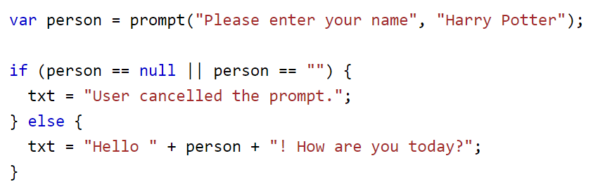
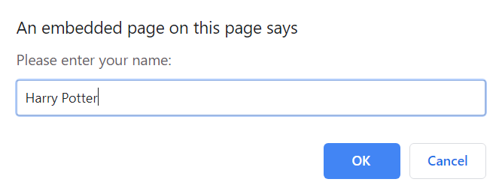
Screen output & Keyboard input
Prompt Box
A prompt box is often used if you want the user to input a value before entering a page.
When a prompt box pops up, the user will have to click either "OK" or "Cancel" to proceed after entering an input value.
If the user clicks "OK" the box returns the input value. If the user clicks "Cancel" the box returns null.
The window.prompt() method can be written without the window prefix.
19

Slide 20
Control Statements
Control statements often require some syntactic container for sequences of statements whose execution they are meant to control.
A compound statement in JavaScript is a sequence of statements delimited by braces.
A control construct is a control statement together with the statement or compound statement whose execution it controls.
JavaScript does not allow compound statements to create local variables.
If a variable is declared in a compound statement, access to it is not confined to that compound statement.
20

Slide 21



Control Statements
Control Expressions
An expression is a combination of values, variables, and operators, which computes to a value.
The computation is called an evaluation.
For example, 5 * 10 evaluates to 50:
Expressions can also contain variable values:
The values can be of various types, such as numbers and strings.
For example, "John" + " " + "Doe", evaluates to "John Doe":
21

Slide 22
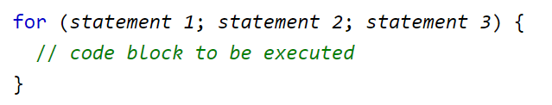
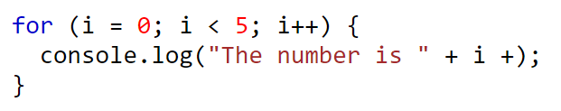
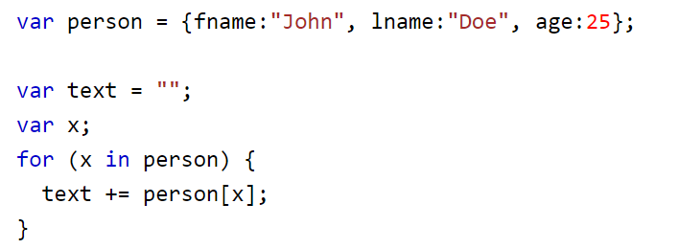
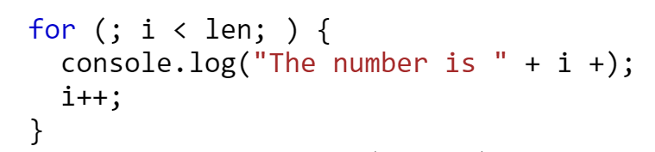
Control Statements: Looping
Looping
JavaScript supports different kinds of loops:
  for - loops through a block of code a number of times
  for/in - loops through the properties of an object
  while - loops through a block of code while a specified condition is true
  do/while - also loops through a block of code while a specified condition is true
22

Slide 23
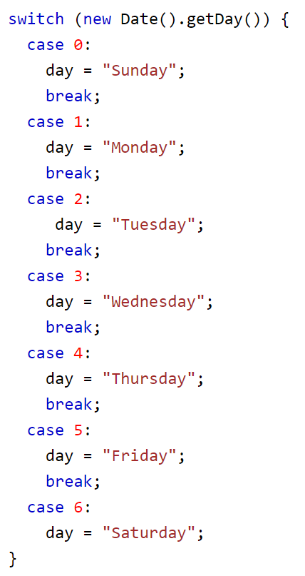
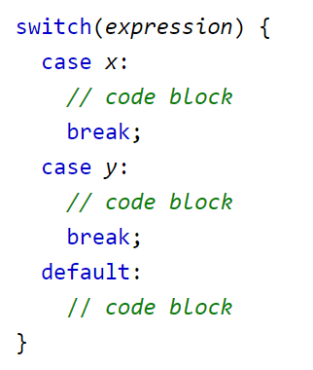
Control Statements: switch
Switch
The switch statement is used to perform different actions based on different conditions and switch statement is used to select one of many code blocks to be executed.
This is how it works:
  The switch expression is evaluated once.
  The value of the expression is compared with the values of each case.
  If there is a match, the associated
  block of code is executed.
When JavaScript reaches a break keyword, it breaks out of the switch block. This will stop the execution of inside the block.
It is not necessary to break the last case in a switch block. The block breaks (ends) there anyway.
The default keyword specifies the code to run if there is no case match.
23

Slide 24
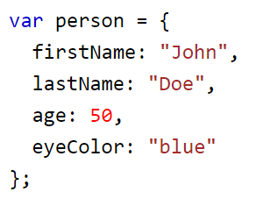
Object Creation & Modification
Java Script Object
The values are written as name : value pairs (name and value separated by a colon)
JavaScript objects are containers for named values called properties or methods.
Object Definition
You define (and create) a JavaScript object with an object literal.
Spaces and line breaks are not important. An object definition can span multiple lines:
24

Slide 25




Object Creation & Modification
Object Properties
The name:values pairs in JavaScript objects are called properties:
Accessing Object Properties: You can access object properties in two ways:
Property | Property Value
firstName | John
lastName | Doe
age | 50
eyeColor | blue
25

Slide 26
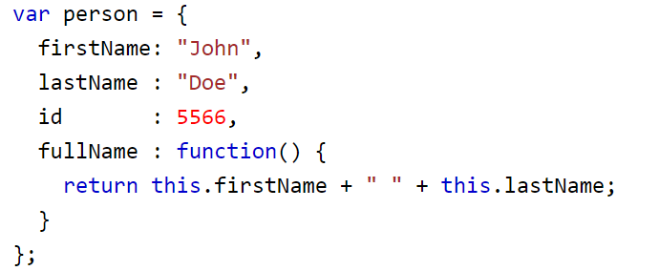



Object Creation & Modification
Object Methods
Objects can also have methods.
Methods are actions that can be performed on objects.
Methods are stored in properties as function definitions.
Accessing Object Methods
You access an object method with the following syntax:
If you access a method without the () parentheses, it will return the function definition:
26

Slide 27
Functions
Functions
A function definition consists of the function’s header and a compound statement that describes the actions of the function. This compound statement is called the body of the function.
A function header consists of the reserved word function, the function’s name, and a parenthesized list of parameters if there are any.
The parentheses are required even if there are no parameters.
A return statement returns control from the function in which it appears to the function’s caller.
Optionally, it includes an expression, whose value is returned to the caller.
A function body may include one or more return statements.
If there are no return statements in a function or if the specific return that is executed does not include an expression, the value returned is undefined. This is also the case if execution reaches the end of the function body without executing a return statement.
Because JavaScript functions are objects, their references can be properties in other objects, in which case they act as methods.
27

Slide 28
Functions
Parameters
The parameter values that appear in a call to a function are called actual parameters.
The parameter names that appear in the header of a function definition, which correspond to the actual parameters in calls to the function, are called formal parameters.
Like C, C++, and Java, JavaScript uses the pass-by-value parameter passing method.
When a function is called, the values of the actual parameters specified in the call are, in effect, copied into their corresponding formal parameters, which behave exactly like local variables. Because references are passed as the actual parameters of objects, the called function has access to the objects and can change them, thereby providing the semantics of pass-by-reference parameters.
However, if a reference to an object is passed to a function and the function changes its corresponding formal parameter (rather than the object to which it points), then the change has no effect on the actual parameter.
28

Slide 29
Functions
Local Variables
The scope of a variable is the range of statements over which it is visible.
When JavaScript is embedded in an HTML document, the scope of a variable is the range of lines of the document over which the variable is visible.
A variable that is not declared with a var statement is implicitly declared by the JavaScript interpreter at the time it is first encountered in the script.
Variables that are implicitly declared have global scope—that is, they are visible in the entire HTML document (or entire file if the script is in its own file)—even if the implicit declaration occurs within a function definition.
Variables that are explicitly declared outside function definitions also have global scope.
It is usually best for variables that are used only within a function to have local scope, meaning that they are visible and can be used only within the body of the function.
Any variable explicitly declared with var in the body of a function has local scope.
If a name that is defined both as a local variable and as a global variable appears in a function, the local variable has precedence, effectively hiding the global variable with the same name.
29

Slide 30
Dynamic HTML
XHTML
content
CSS
style rules
appearance
manipulate
manipulate
Scripting
Language

Slide 31
What is DHTML?
DHTML is the combination of several built-in browser features in fourth generation browsers that enable a web page to be more dynamic.
DHTML is NOT a scripting language (like JavaScript or VBscript), but a browser feature- or enhancement- that makes the browser dynamic
It uses a host of different technologies - JavaScript, VBScript, the Document Object Model (DOM), layers, cascading stylesheets - to create HTML that can change even after a page has been loaded into a browser

Slide 32
What is DHTML?
It is considered to be made up of
  HTML
  Cascading Style Sheets (CSS)
  Scripting language
All three of these components are linked via Document Object Model (DOM)
DOM is the interface that allows scripting languages to access the content, style, and structure of the web documents and change them dynamically

Slide 33
Tools of DTHML
HTML and XML
  Partitions and Organizes the content
CSS
  Defines the Presentation of the content
Scripting - JavaScript, JScript, VBScript
  Adds interactivity to the page
DOM- Document Object Model
  Defines what and how elements are exposed for script access

Slide 34
Components of DHTML
DHTML requires four independent components to work: HTML, Cascading Style Sheets, Scripting and the Document Object Model. The section provides a brief description of each component.
  HTML:
  HTML defines the structure of a Web page, using such basic elements as headings, forms, tables, paragraphs and links. On December 18, 1997, HTML 4.0 attained "recommended" status at the W3C. Changes and enhancements introduced in HTML 4.0 made DHTML possible.
  2. Cascading Style Sheets (CSS): Similar to a template in a word-processing document, a style sheet controls the formatting of HTML elements. Like in traditional desktop publishing, one can use style sheet to specify page margins, point sizes and leading. Cascading Style Sheets is a method to determine precedence and to resolve conflicts when multiple styles are used.

Slide 35
  3. Scripting:
  Scripting provides the mechanisms to interpret user actions and produce client-side changes to a page. For example, scripts can interpret mouse actions (such as the mouse passing over a specified area of a page through the event model) and respond to the action by using a set of predefined instructions (such as highlighting the text activated by the mouse action). Although DHTML can communicate with several scripting languages, JavaScript is the de facto standard for creating cross-browser DHTML pages.
  4. Document Object Model (DOM):
  The DOM outlines Web page content in a way that makes it possible for HTML elements, style sheets and scripting languages to interact with each other. The W3C defines the DOM as "a platform- and language-neutral interface that will allow programs and scripts to dynamically access and update the content, structure, and style of documents. The document can be further processed and the results of that processing can be incorporated back into the presented stage."

Slide 36
DOM – Document Object Model

Slide 37
DOM Introduction
Dynamic HTML object model
  “The Document Object Model (DOM) is an application programming interface (API) for HTML and XML documents. It defines the logical structure of documents and the way a document is accessed and manipulated.”
  Great control over presentation of pages
    Access to all elements on the page
  Whole web page (elements, forms, frames, tables, etc.) represented in an object hierarchy
  “Anything found in an HTML or XML document can be accessed, changed, deleted, or added using the Document Object Model, with a few exceptions.”

Slide 38
DOM Introduction cont’d
Document Object Model
  Your web browser builds a model of the web page (the document) that includes all the objects in the page (tags, text, etc)
  All of the properties, methods, and events available to the web developer for manipulating and creating web pages are organized into objects
  Those objects are accessible via scripting languages in modern web browsers

Slide 39
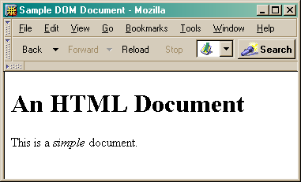
This is what the browser reads
<html>
<head>
<title>Sample DOM Document</title>
</head>
<body>
<h1>An HTML Document</h1>
<p>This is a <i>simple</i> document.
</body>
</html>
This is what the browser displays on screen.

Slide 40
Document
This is a drawing of the model that the browser is working with for the page.
<html>
<head>
<body>
<title>
"Sample DOM Document"
<h1>
<p>
"An HTML Document"
"This is a"
<i>
"document"
"simple"

Slide 41
DOM Introduction – cont’d
HTML elements treated as objects
  Attributes of these elements treated as properties of those objects
    Objects identified with an ID attribute can be scripted with languages like JavaScript and VBScript.
    Elements on the page can be supported by scripting that can interact with user events and change the page content dynamically.
    The DOM dictates how the written scripting language controls the elements on the screen, such as graphics and text.

Slide 42
DOM-Document Object Model …
The Document Object Model is a platform- and language-neutral interface that will allow programs and scripts to dynamically access and update the content, structure and style of the document.
The DOM details the characteristic properties of each element of a Web page, thereby detailing how we might manipulate these components and, in turn, manipulate the page

Slide 43
DOM-Document Object Model…
Document Object Model is not a "part" of Scripting languages. The DOM stands alone, able to be interfaced with any programming language designed to do so
The W3C DOM is the recommended standard to be exposed by each browser
Microsoft Internet Explorer and Netscape do not share the same DOM.

Slide 44
DOM-Document Object Model…
Both (IE and Netscape) DOMs break down Web pages into roughly four types of components
  Objects, Properties, Events and Methods
Objects :
  Container which reflects a particular element of a page
  objects "contain" the properties and methods which apply to that element

Slide 45
DOM-Document Object Model…
Properties:
  Characteristics of an object
  Example: the ‘document’ object possesses a ‘bgColor’ property which reflects the background color of the page.
  Using a programming language (e.g. JavaScript) you may, via this property, read or modify the background color of a page

Slide 46
DOM-Document Object Model…
Methods:
  A method typically executes an action which acts upon the object by which it is owned
Events:
  Used to trap actions related to its owning object
  Typically, these actions are caused by the user

Slide 47
DOM
  DOM = Document Object Model
  Defines a hierarchical model of the document structure
  through which all document elements may be accessed
  Nodes
  The W3C DOM defines element of a document is a node
  of a particular type
  Node Types
  Common types are: document node, element node, text
  node, attribute node, comment node, document-type node

Slide 48
DOM Example
document node
Document_type node
<!DOCTYPE>
element node
<HTML>
element node
<HEAD>
element node
<BODY>
element node
<TITLE>
element node
<P>
text node
"Sample"
text node
"This is a..."

Slide 49
Netscape DOM
DOM "begins" at the window object;
Other objects are below the window object in the hierarchy
Exception is the navigator object, (whose properties provide information about the browser version,) which is a peer object of window rather than a child

Slide 50
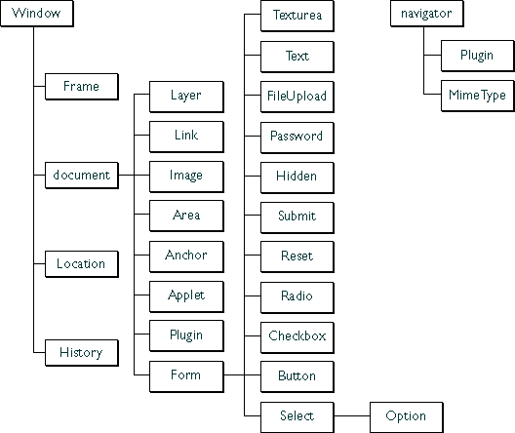

Slide 51
Conclusion – Overview…
DHTML can make your browser dynamic and interactive
Content and design can be separated using Style sheets & uniformity of the site can be maintained using them
Validation of input’s given by the user can be done at the client side, without connection to the server
Drop down menus can be used to put a lot of information on the site

Slide 52
HTML DOM

Slide 53
HTML DOM
From W3C:
“A platform- and language-neutral interface that allows programs and scripts to dynamically access and update the content and structure of HTML and XHTML documents.”

Slide 54
DOM and JavaScript
Combined with JavaScript, every element in the HTML document is represented by an object
Elements can be manipulated using the properties and methods of the corresponding objects
Changes in the element properties are immediately reflected by the browser

Slide 55
Accessing HTML Elements
All HTML elements (objects) are accessed through the document object
document itself is automatically created
Several ways to access a specific element
  paths in the DOM tree
  retrieval by tag
  retrieval by ID

Slide 56
HTML DOM Tree

Slide 57
The HTML DOM Document Object
HTML DOM Nodes
In the HTML DOM (Document Object Model), everything is a node:
The document itself is a document node
All HTML elements are element nodes
All HTML attributes are attribute nodes
Text inside HTML elements are text nodes
Comments are comment nodes

Slide 58
The Document Object
When an HTML document is loaded into a web browser, it becomes a document object.
The document object is the root node of the HTML document and the "owner" of all other nodes:
(element nodes, text nodes, attribute nodes, and comment nodes).
The document object provides properties and methods to access all node objects, from within JavaScript.
Tip: The document is a part of the Window object and can be accessed as window.document.

Slide 59
Property / Method | Description
document.activeElement | Returns the currently focused element in the document
document.addEventListener() | Attaches an event handler to the document
document.adoptNode() | Adopts a node from another document
document.anchors | Returns a collection of all <a> elements in the document that have a name attribute
document.applets | Returns a collection of all <applet> elements in the document
document.baseURI | Returns the absolute base URI of a document
document.body | Sets or returns the document's body (the <body> element)
document.close() | Closes the output stream previously opened with document.open()
document.cookie | Returns all name/value pairs of cookies in the document
document.createAttribute() | Creates an attribute node

Slide 60
The Element Object
In the HTML DOM, the Element object represents an HTML element.
Element objects can have child nodes of type element nodes, text nodes, or comment nodes.
A NodeList object represents a list of nodes, like an HTML element's collection of child nodes.
Elements can also have attributes. Attributes are attribute nodes.

Slide 61
Property / Method | Description
element.accessKey | Sets or returns the accesskey attribute of an element
element.addEventListener() | Attaches an event handler to the specified element
element.appendChild() | Adds a new child node, to an element, as the last child node
element.attributes | Returns a NamedNodeMap of an element's attributes
element.blur() | Removes focus from an element
element.childElementCount | Returns the number of child elements an element has

Slide 62
HTML DOM Events
HTML DOM events allow JavaScript to register different event handlers on elements in an HTML document.
Events are normally used in combination with functions, and the function will not be executed before the event occurs (such as when a user clicks a button).
Tip: The event model was standardized by the W3C in DOM Level 2.

Slide 63
Event | Description | DOM
onclick | The event occurs when the user clicks on an element | 2
oncontextmenu | The event occurs when the user right-clicks on an element to open a context menu | 3
ondblclick | The event occurs when the user double-clicks on an element | 2
onmousedown | The event occurs when the user presses a mouse button over an element | 2
onmouseenter | The event occurs when the pointer is moved onto an element | 2
onmouseleave | The event occurs when the pointer is moved out of an element | 2
onmousemove | The event occurs when the pointer is moving while it is over an element | 2
onmouseover | The event occurs when the pointer is moved onto an element, or onto one of its children | 2
onmouseout | The event occurs when a user moves the mouse pointer out of an element, or out of one of its children | 2
onmouseup | The event occurs when a user releases a mouse button over an element | 2

Slide 64
Keyboard Events
Event | Description | DOM
onkeydown | The event occurs when the user is pressing a key | 2
onkeypress | The event occurs when the user presses a key | 2
onkeyup | The event occurs when the user releases a key | 2

Slide 65
Frame/Object Events
Event | Description | DOM
onabort | The event occurs when the loading of a resource has been aborted | 2
onbeforeunload | The event occurs before the document is about to be unloaded | 2
onerror | The event occurs when an error occurs while loading an external file | 2
onhashchange | The event occurs when there has been changes to the anchor part of a URL | 3
onload | The event occurs when an object has loaded | 2
onpageshow | The event occurs when the user navigates to a webpage | 3

Slide 66
onpagehide | The event occurs when the user navigates away from a webpage | 3
onresize | The event occurs when the document view is resized | 2
onscroll | The event occurs when an element's scrollbar is being scrolled | 2
onunload | The event occurs once a page has unloaded (for <body>)

Slide 67
Form Events
Event | Description | DOM
onblur | The event occurs when an element loses focus | 2
onchange | The event occurs when the content of a form element, the selection, or the checked state have changed (for <input>, <keygen>, <select>, and <textarea>) | 2
onfocus | The event occurs when an element gets focus | 2
onfocusin | The event occurs when an element is about to get focus | 2
onfocusout | The event occurs when an element is about to lose focus | 2
oninput | The event occurs when an element gets user input | 3
oninvalid | The event occurs when an element is invalid | 3
onreset | The event occurs when a form is reset | 2

Slide 68
onsearch | The event occurs when the user writes something in a search field (for <input="search">) | 3
onselect | The event occurs after the user selects some text (for <input> and <textarea>) | 2
onsubmit | The event occurs when a form is submitted | 2

Slide 69
Clipboard Events
Event | Description | DOM
oncopy | The event occurs when the user copies the content of an element
oncut | The event occurs when the user cuts the content of an element
onpaste | The event occurs when the user pastes some content in an element

Slide 70
DOM Events

Slide 71
Onclick
<!DOCTYPE html>
<html>
<body>
<p>Click the button to trigger a function that will output "Hello World" in a p element with id="demo".</p>
<button onclick="myFunction()">Click me</button>
<p id="demo"></p>
<script>
function myFunction() {
document.getElementById("demo").innerHTML = "Hello World";
}
</script>
</body>
</html>

Slide 72
<!DOCTYPE html>
<html>
<body>
<p>This example demonstrates how to assign an "onclick" event to a p element.</p>
<p id="demo" onclick="myFunction()">Click me.</p>
<script>
function myFunction() {
document.getElementById("demo").innerHTML = "YOU CLICKED ME!";
}
</script>
</body>
</html>

Slide 73
<!DOCTYPE html>
<html>
<body>
<p>This example uses the HTML DOM to assign an "onclick" event to a p element.</p>
<p id="demo">Click me.</p>
<script>
document.getElementById("demo").onclick = function() {myFunction()};
function myFunction() {
document.getElementById("demo").innerHTML = "YOU CLICKED ME!";
}
</script>
</body>
</html>

Slide 74
onmouseenter Event
Definition and Usage
The onmouseenter event occurs when the mouse pointer is moved onto an element.
Tip: This event is often used together with the onmouseleave event, which occurs when the mouse pointer is moved out of an element.
Tip: The onmouseenter event is similar to the onmouseover event. The only difference is that the onmouseenter event does not bubble (does not propagate up the document hierarchy).

Slide 75
<!DOCTYPE html>
<html>
<body>
<p>This example demonstrates how to assign an "onmouseenter" and "onmouseleave" event to a h1 element.</p>
<h1 id="demo" onmouseenter="mouseEnter()" onmouseleave="mouseLeave()">Mouse over me</h1>
<script>
function mouseEnter() {
document.getElementById("demo").style.color = "red";
}
function mouseLeave() {
document.getElementById("demo").style.color = "black";
}
</script>
</body>
</html>

Slide 76
<!DOCTYPE html>
<html>
<body>
<p>This example uses the HTML DOM to assign an "onmouseenter" and "onmouseleave" event to a h1 element.</p>
<h1 id="demo">Mouse over me</h1>
<script>
document.getElementById("demo").onmouseenter = function() {mouseEnter()};
document.getElementById("demo").onmouseleave = function() {mouseLeave()};
function mouseEnter() {
document.getElementById("demo").style.color = "red";
}
function mouseLeave() {
document.getElementById("demo").style.color = "black";
}
</script>
</body>
</html>

Slide 77
onkeydown Event

Slide 78
<!DOCTYPE html>
<html>
<body>
<p>A function is triggered when the user is pressing a key in the input field.</p>
<input type="text" onkeydown="myFunction()">
<script>
function myFunction() {
alert("You pressed a key inside the input field");
}
</script>
</body>
</html>

Slide 79
<!DOCTYPE html>
<html>
<body>
<p>This example demonstrates how to assign an "onkeydown" event to an input element.</p>
<p>Press a key inside the text field to set a red background color.</p>
<input type="text" id="demo" onkeydown="myFunction()">
<script>
function myFunction() {
document.getElementById("demo").style.backgroundColor = "red";
}
</script>
</body>
</html>

Slide 80
<!DOCTYPE html>
<html>
<body>
<p>This example uses the HTML DOM to assign an "onkeydown" event to an input element.</p>
<p>Press a key inside the text field to set a red background color.</p>
<input type="text" id="demo">
<script>
document.getElementById("demo").onkeydown = function() {myFunction()};
function myFunction() {
document.getElementById("demo").style.backgroundColor = "red";
}
</script>
</body>
</html>

Slide 81
onkeyup Event
The onkeyup event occurs when the user releases a key (on the keyboard)

Slide 82
<!DOCTYPE html>
<html>
<body>
<p>A function is triggered when the user releases a key in the input field. The function transforms the character to upper case.</p>
Enter your name: <input type="text" id="fname" onkeyup="myFunction()">
<script>
function myFunction() {
var x = document.getElementById("fname");
x.value = x.value.toUpperCase();
}
</script>
</body>
</html>

Slide 83
<!DOCTYPE html>
<html>
<body>
<p>This example uses the HTML DOM to assign an "onkeyup" event to an input element.</p>
<p>Press a key inside the text field and release it to set the text to uppercase.</p>
Enter your name: <input type="text" id="fname">
<script>
document.getElementById("fname").onkeyup = function() {myFunction()};
function myFunction() {
var x = document.getElementById("fname");
x.value = x.value.toUpperCase();
}
</script>
</body>
</html>

Slide 84
Frame/Object Events

Slide 85
onerror Event
Definition and Usage
The onerror event is triggered if an error occurs while loading an external file (e.g. a document or an image).

Slide 86
<!DOCTYPE html>
<html>
<body>
<img src="image.gif" onerror="myFunction()">
<p>A function is triggered if an error occurs when loading the image. The function shows an alert box with a text.
In this example we refer to an image that does not exist, therefore the onerror event occurs.</p>
<script>
function myFunction() {
alert('The image could not be loaded.');
}
</script>
</body>
</html>

Slide 87
<!DOCTYPE html>
<html>
<body>
<p>This example uses the HTML DOM to assign an "onerror" event to an img element.</p>
<img id="myImg" src="image.gif">
<p id="demo"></p>
<script>
document.getElementById("myImg").onerror = function() {myFunction()};
function myFunction() {
document.getElementById("demo").innerHTML = "The image could not be loaded.";
}
</script>
</body>
</html>

Slide 88
onload Event
Definition and Usage
The onload event occurs when an object has been loaded.
onload is most often used within the <body> element to execute a script once a web page has completely loaded all content (including images, script files, CSS files, etc.).
The onload event can be used to check the visitor's browser type and browser version, and load the proper version of the web page based on the information.
The onload event can also be used to deal with cookies

Slide 89
<!DOCTYPE html>
<html>
<body onload="myFunction()">
<h1>Hello World!</h1>
<script>
function myFunction() {
alert("Page is loaded");
}
</script>
</body>
</html>

Slide 90
<!DOCTYPE html>
<html>
<body>
<p>This example uses the HTML DOM to assign an "onload" event to an iframe element.</p>
<iframe id="myFrame" src="/default.asp"></iframe>
<p id="demo"></p>
<script>
document.getElementById("myFrame").onload = function() {myFunction()};
function myFunction() {
document.getElementById("demo").innerHTML = "Iframe is loaded.";
}
</script>
</body>
</html>

Slide 91
"onresize" event

Slide 92
<!DOCTYPE html>
<html>
<body onresize="myFunction()">
<p>This example demonstrates how to assign an "onresize" event to a body element.</p>
<p>Try to resize the browser window.</p>
<p>Window resized <span id="demo">0</span> times.</p>
<script>
var x = 0;
function myFunction() {
var txt = x += 1;
document.getElementById("demo").innerHTML = txt;
}
</script>
</body>
</html>

Slide 93
<!DOCTYPE html>
<html>
<body>
<p>This example uses the HTML DOM to assign an "onresize" event to the body element.</p>
<p>Try to resize the browser window.</p>
<p>Window resized <span id="demo">0</span> times.</p>
<script>
document.getElementsByTagName("BODY")[0].onresize = function() {myFunction()};
var x = 0;
function myFunction() {
var txt = x += 1;
document.getElementById("demo").innerHTML = txt;
}
</script>
</body>
</html>

Slide 94
onunload event
Definition and Usage
The onunload event occurs once a page has unloaded (or the browser window has been closed).
onunload occurs when the user navigates away from the page (by clicking on a link, submitting a form, closing the browser window, etc.).
Note: The onunload event is also triggered when a user reloads the page (and the onload event).

Slide 95
<!DOCTYPE html>
<html>
<body onunload="myFunction()">
<h1>Welcome to my Home Page</h1>
<p>Close this window or press F5 to reload the page.</p>
<p><strong>Note:</strong> Due to different browser settings, this event may not always work as expected.</p>
<script>
function myFunction() {
alert("Thank you for visiting W3Schools!");
}
</script>
</body>
</html>

Slide 96
Form Events

Slide 97
<!DOCTYPE html>
<html>
<body>
<form action="action_page.php">
First name:<br>
<input type="text" value="Mickey">
<br>
Last name:<br>
<input type="text" name="lastname" value="Mouse">
<br><br>
<input type="submit" value="Submit">
</form>
<p>If you click the "Submit" button, the form-data will be sent to a page called "action_page.php".</p>
<p>Notice that the value of the "First name" field will not be submitted, because the input element does not have a name attribute.</p>
</body>
</html>

Slide 98
onblur Event
The onblur event occurs when an object loses focus.
The onblur event is most often used with form validation code (e.g. when the user leaves a form field).
Tip: The onblur event is the opposite of the onfocus event.
Tip: The onblur event is similar to the onfocusout event. The main difference is that the onblur event does not bubble. Therefore, if you want to find out whether an element or its child loses focus, you could use the onfocusout event.

Slide 99
Syntax
In HTML:
<element onblur="myScript">
In JavaScript:
object.onblur=function(){myScript};

Slide 100
<!DOCTYPE html>
<html>
<body>
<p>This example demonstrates how to assign an "onblur" event to an input element.</p>
<p>Write something in the input field, and then click outside the field to lose focus (blur).</p>
<input type="text" onblur="myFunction()">
<script>
function myFunction() {
alert("Input field lost focus.");
}
</script>
</body>
</html>

Slide 101
<!DOCTYPE html>
<html>
<body>
<p>This example uses the HTML DOM to assign an "onblur" event to an input element.</p>
<p>Write something in the input field, and then click outside the field to lose focus (blur).</p>
<input type="text" id="fname">
<script>
document.getElementById("fname").onblur = function() {myFunction()};
function myFunction() {
alert("Input field lost focus.");
}
</script>
</body>
</html>

Slide 102
onfocus Event
Definition and Usage
The onfocus event occurs when an element gets focus.
The onfocus event is most often used with <input>, <select>, and <a>.
Tip: The onfocus event is the opposite of the onblur event.
Tip: The onfocus event is similar to the onfocusin event. The main difference is that the onfocus event does not bubble. Therefore, if you want to find out whether an element or its child gets the focus, you could use the onfocusin event.

Slide 103
<!DOCTYPE html>
<html>
<body>
<p>This example demonstrates how to assign an "onfocus" event to an input element.</p>
Enter your name: <input type="text" id="fname" onfocus="myFunction()">
<script>
function myFunction() {
document.getElementById("fname").style.backgroundColor = "red";
}
</script>
</body>
</html>

Slide 104
<!DOCTYPE html>
<html>
<body>
<p>This example uses the HTML DOM to assign an "onfocus" event to an input element.</p>
Enter your name: <input type="text" id="fname">
<script>
document.getElementById("fname").onfocus = function() {myFunction()};
function myFunction() {
document.getElementById("fname").style.backgroundColor = "red";
}
</script>
</body>
</html>

Slide 105
onfocusin Event
Definition and Usage
The onfocusin event occurs when an element is about to get focus.
Tip: The onfocusin event is similar to the onfocus event. The main difference is that the onfocus event does not bubble. Therefore, if you want to find out whether an element or its child gets the focus, you should use the onfocusin event.

Slide 106
<!DOCTYPE html>
<html>
<body>
<p>This example demonstrates how to assign an "onfocusin" event to an input element.</p>
Enter your name: <input type="text" id="fname" onfocusin="myFunction()">
<p><strong>Note:</strong> Firefox does not support the onfocusin event.</p>
<script>
function myFunction() {
document.getElementById("fname").style.backgroundColor = "red";
}
</script>
</body>
</html>

Slide 107
onfocusout Event
Definition and Usage
The onfocusout event occurs when an element is about to lose focus.
Tip: The onfocusout event is similar to the onblur event. The main difference is that the onblur event does not bubble. Therefore, if you want to find out whether an element or its child loses focus, you should use the onfocusout event.

Slide 108
<!DOCTYPE html>
<html>
<body>
<p>This example demonstrates how to assign an "onfocusout" event to an input element.</p>
<p>Write something in the input field, and then click outside the field to lose focus.</p>
<input type="text" onfocusout="myFunction()">
<p><strong>Note:</strong> Firefox does not support the onfocusout event.</p>
<script>
function myFunction() {
alert("Input field lost focus.");
}
</script>
</body>
</html>

Slide 109
<!DOCTYPE html>
<html>
<body>
<p>This example uses the HTML DOM to assign an "onfocusout" event to an input element.</p>
<p>Write something in the input field, and then click outside the field to lose focus.</p>
<input type="text" id="fname">
<p><strong>Note:</strong> Firefox does not support the onfocusout event.</p>
<p><strong>Note:</strong> This example may not work as expected in Chrome, Safari and Opera 15+.</p>
<script>
document.getElementById("fname").onfocusout = function() {myFunction()};
function myFunction() {
alert("Input field lost focus.");
}
</script>
</body>
</html>

Slide 110
oninput Event
Definition and Usage
The oninput event occurs when an element gets user input.
This event occurs when the value of an <input> or <textarea> element is changed.
Tip: This event is similar to the onchange event. The difference is that the oninput event occurs immediately after the value of an element has changed, while onchange occurs when the element loses focus, after the content has been changed. The other difference is that the onchange event also works on <keygen> and <select> elements.

Slide 111
<!DOCTYPE html>
<html>
<body>
<p>Write something in the text field to trigger a function.</p>
<input type="text" id="myInput" oninput="myFunction()">
<p id="demo"></p>
<script>
function myFunction() {
var x = document.getElementById("myInput").value;
document.getElementById("demo").innerHTML = "You wrote: " + x;
}
</script>
</body>
</html>

Slide 112
<!DOCTYPE html>
<html>
<body>
<p>This example uses the HTML DOM to assign an "oninput" event to an input element.</p>
<p>Write something in the text field to trigger a function.</p>
Enter name: <input type="text" id="myInput" value="Mickey">
<script>
document.getElementById("myInput").oninput = function() {myFunction()};
function myFunction() {
alert("The value of the input field was changed.");
}
</script>
</body>
</html>

Slide 113
onsubmit Event
The onsubmit event occurs when a form is submitted.

Slide 114
<!DOCTYPE html>
<html>
<body>
<p>This example demonstrates how to assign an "onsubmit" event to a form element.</p>
<p>When you submit the form, a function is triggered which alerts some text.</p>
<form action="demo_form.asp" onsubmit="myFunction()">
Enter name: <input type="text" name="fname">
<input type="submit" value="Submit">
</form>
<script>
function myFunction() {
alert("The form was submitted");
}
</script>
</body>
</html>

Slide 115
<!DOCTYPE html>
<html>
<body>
<p>This example uses the HTML DOM to assign an "onsubmit" event to a form element.</p>
<p>When you submit the form, a function is triggered which alerts some text.</p>
<form id="myForm" action="demo_form.asp">
Enter name: <input type="text" name="fname">
<input type="submit" value="Submit">
</form>
<script>
document.getElementById("myForm").onsubmit = function() {myFunction()};
function myFunction() {
alert("The form was submitted");
}
</script>
</body>
</html>

Slide 116
Manipulating the Document Structure

Slide 117
Structure Manipulation
In structure manipulation, we
  add/remove/replace HTML elements
  change the text under elements
Two approaches:
  DOM tree manipulation (W3C specification)
  Setting the innerHTML attribute (not a specification)

Slide 118
DOM Tree Manipulation
In this approach, we explicitly
  create new nodes
  add created nodes to the DOM tree
  remove old nodes
To create new nodes, use these methods of document:
  document.createElement("tag")
  document.createTextNode("text")
  document.createAttribute("attname")

Slide 119
DOM Tree Manipulation (cont)
To add and remove children of a specific element, use the following methods:
  element.appendChild(newChild)
  element.insertBefore(newChild, child)
  element.removeChild(child)
  element.replaceChild(newChild, oldChild)

Slide 120
An Example
<html>
<head><script type="text/javascript">...</script></head>
<body>
<p>First Paragraph.</p>
<div id="d1"><p id="p1">Second paragraph.</p></div>
<p>
<input type="button" value="replace" onclick="replace(this)" />
</p>
</body>
</html>

Slide 121
An Example (cont)
function replace(button) {
d = document.getElementById("d1");
p = document.getElementById("p1");
h = document.createElement("h1");
text = document.createTextNode("This is a header.");
h.appendChild(text);
d.replaceChild(h,p);
button.disabled=true;
}

Slide 122
The innerHTML Property
The attribute innerHTML attribute of an element is the HTML code embedded inside that element
Hence, you can replace existing content by setting this attribute:
  element.innerHTML = "new HTML code"
Not recognized by W3C specifications, but supported by Web browsers

Slide 123
Previous Example with innerHTML
function replace(button) {
d = document.getElementById("d1");
d.innerHTML = "<h1>This is a header<\/h1>";
button.disabled=true;
}

Slide 124
The window Object

Slide 125
The window Object
Built-in object called window
Represents the browser window of the document
Several window objects may co-exist
  Separate windows/tabs
  Separate frames
Default object – need not specify window to access its properties and methods
  window.alert() and alert() are the same

Slide 126
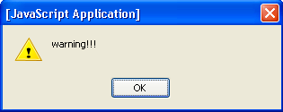
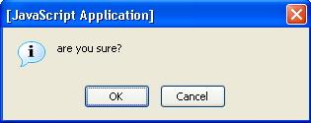
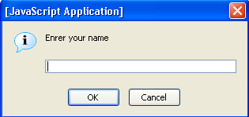
Dialog Boxses
alert("warning!!!");
confirm("are you sure?");
  returned value is Boolean
prompt("enter your name");
  returned value is either a string or a null object
Rendering stops until box closure!

Slide 127
An Example
<script type="text/javascript">
alert("You are about to start");
document.write("Started<br/>");
conf = confirm("Should I continue?");
if(conf) {
name = prompt("Enrer your name")
document.write("Your name is " + name +".<br/>");
}
</script>

Slide 128
The location Object
The object window.location represents the current URL of the window
For example:
  location.href - the current URL (can be changed!)
  location.hostname
  location.pathname
Also has methods:
  location.reload(),
  location.replace(‘URL’)

Slide 129
Opening New Windows
window.open("URL") - opens URL in a new window
  you can specify other properties, like size, whether it is resizable, etc.
  returns the new window object

Slide 130
Accessing Window Frames
window.top - the topmost window
window.frames - a collection of the frames in the window
For example, in a specific frame, use window.top.frames[i] to get to another frame

Slide 131
The navigator Object
The object window.navigator contains information about the browser
For example:
  navigator.appName - the name of the browser
  navigator.appVersion - the version of the browser
  navigator.cookieEnabled
  navigator.platform - the OS name

Slide 132
The history Object
The object window.history enables navigation according to the navigation history
For example:
  history.back() - same as clicking the back button
  history.forward() - same as clicking the forward button
  history.go(i) - go forward i times
    If i is negative, go back -i times

